Slide 1
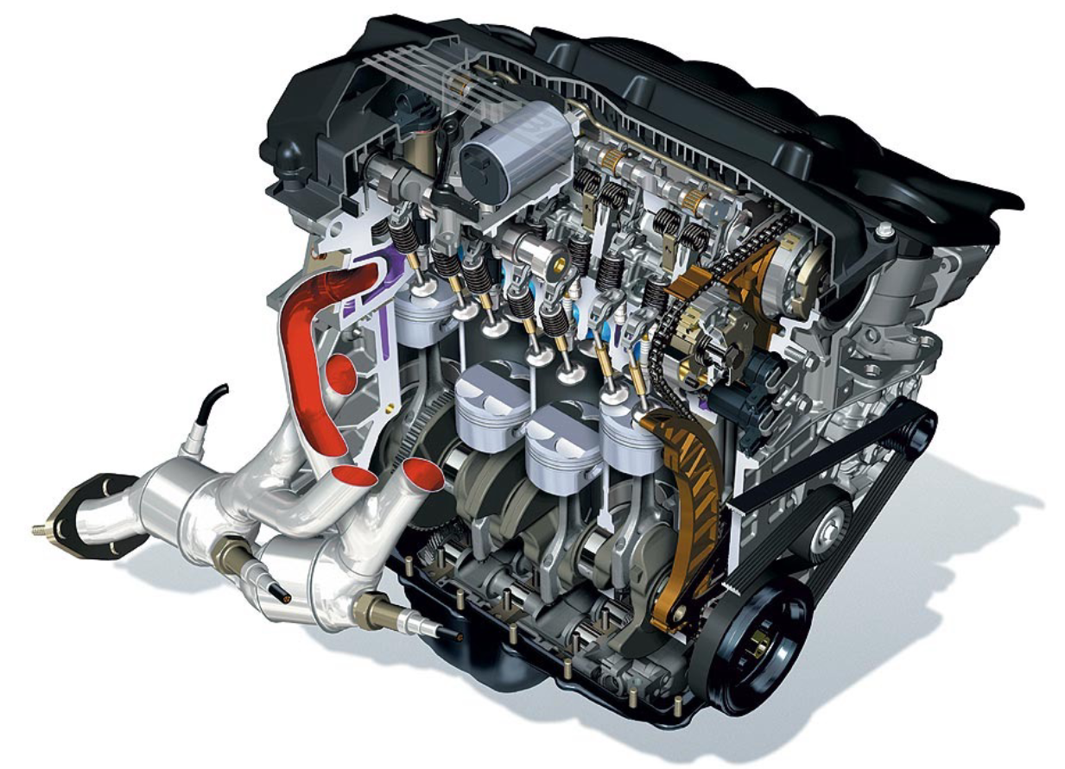
Engines and Fuel cells
Exercise ENG3

Slide 2
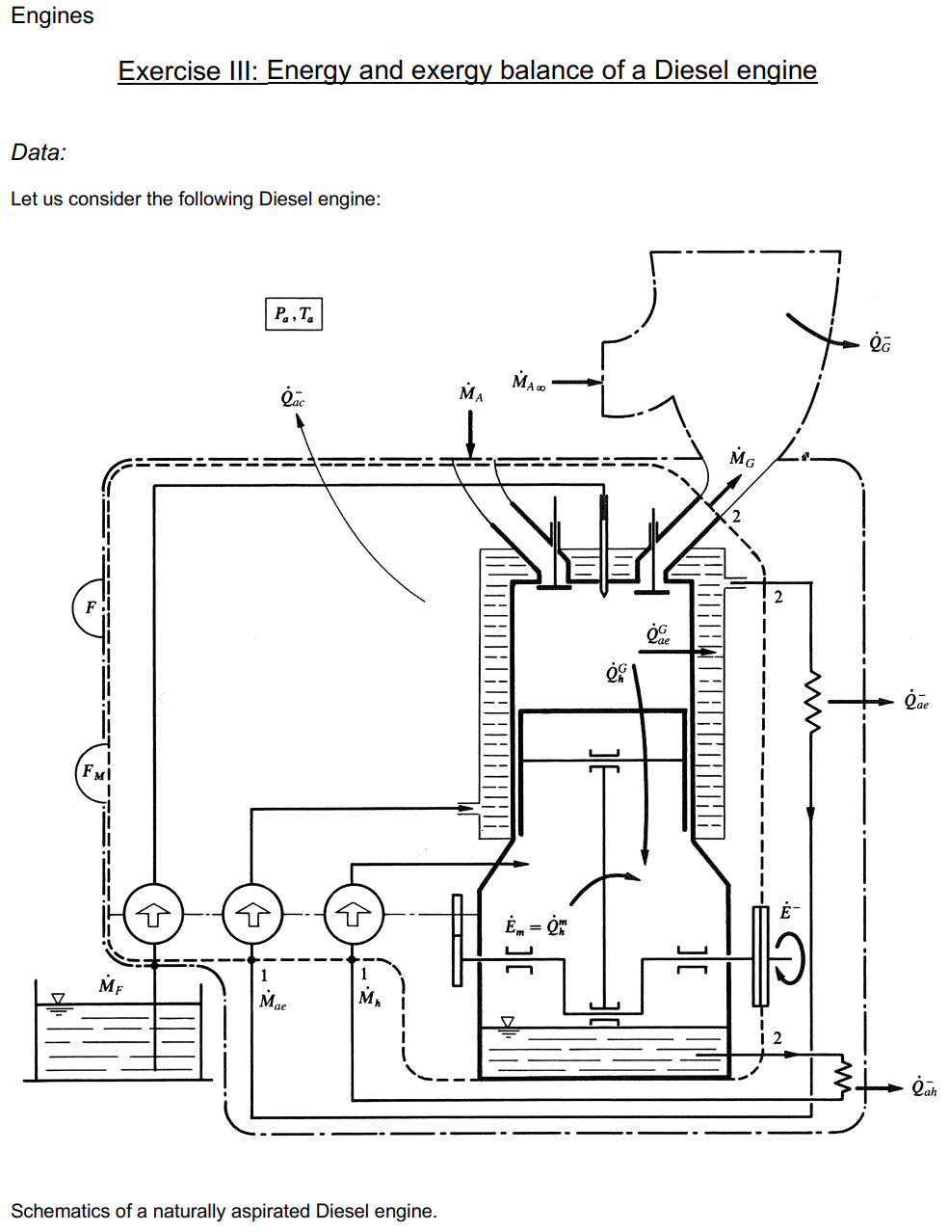
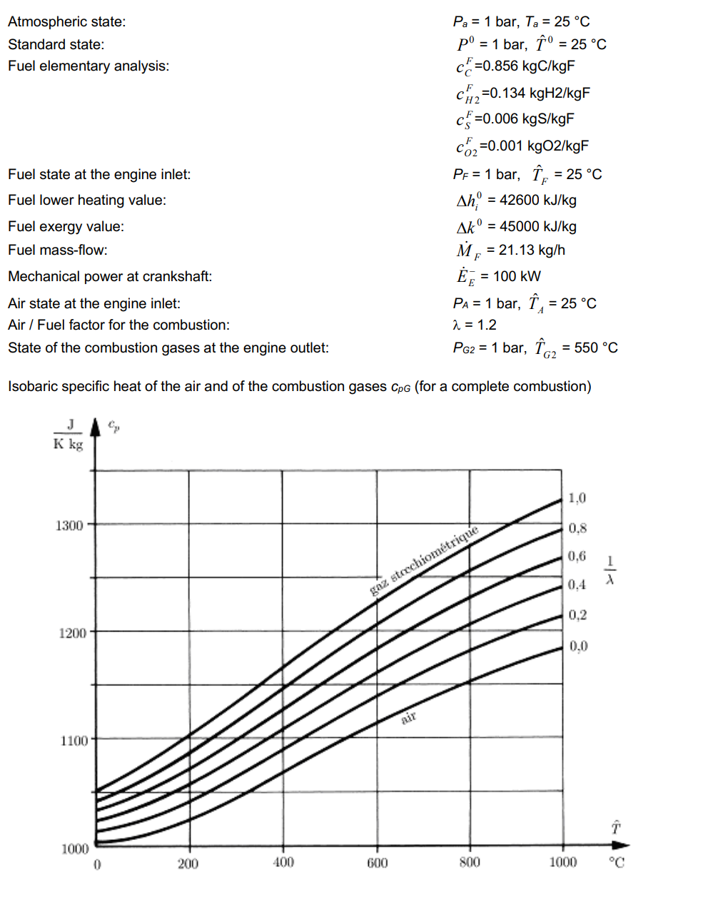
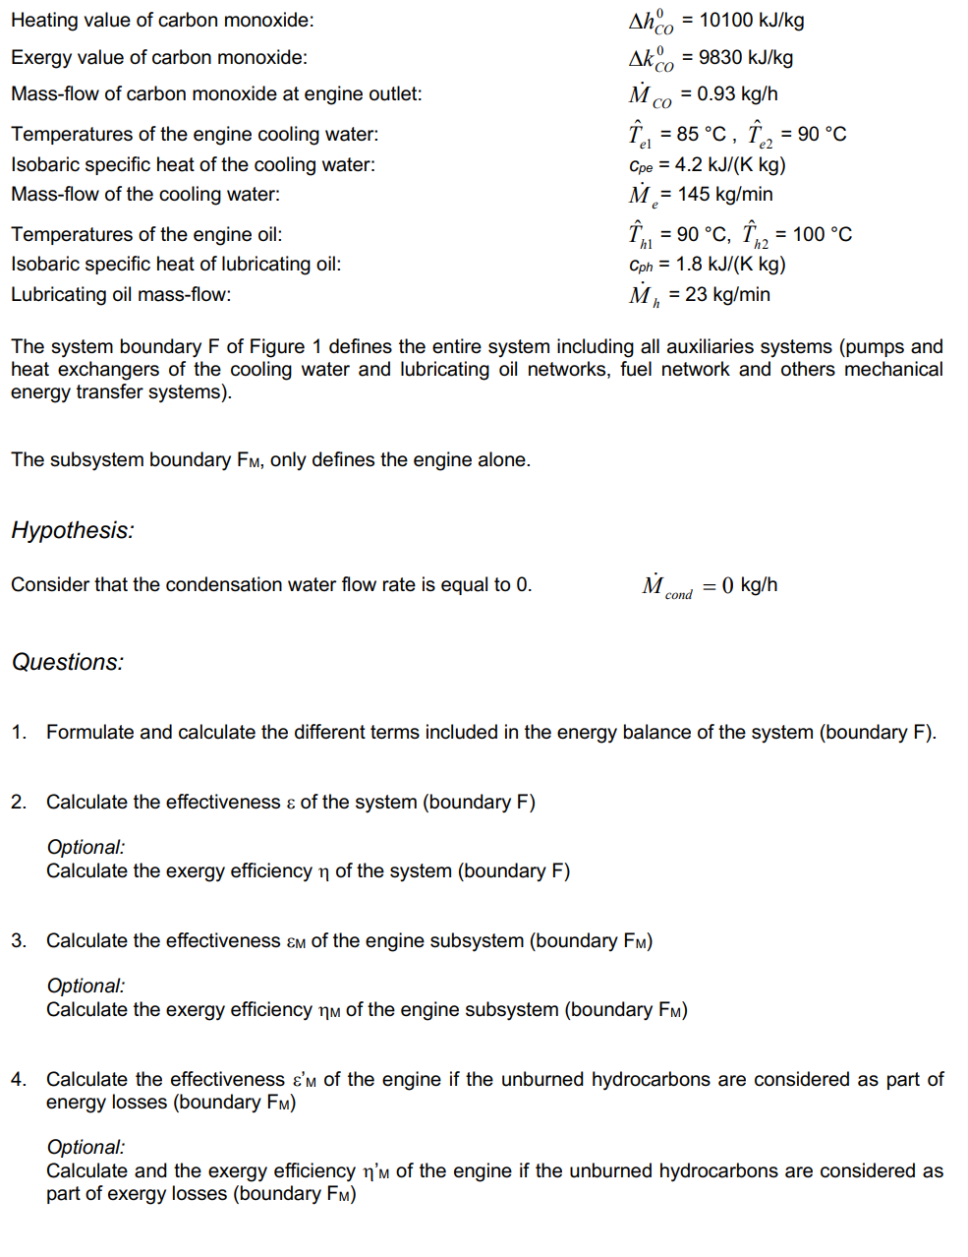
Exercise ENG3: Energy and exergy balance of a Diesel engine
Reference:
1. Formula Memento, Page 11
2. Lecture 4, page 31-36

Slide 3
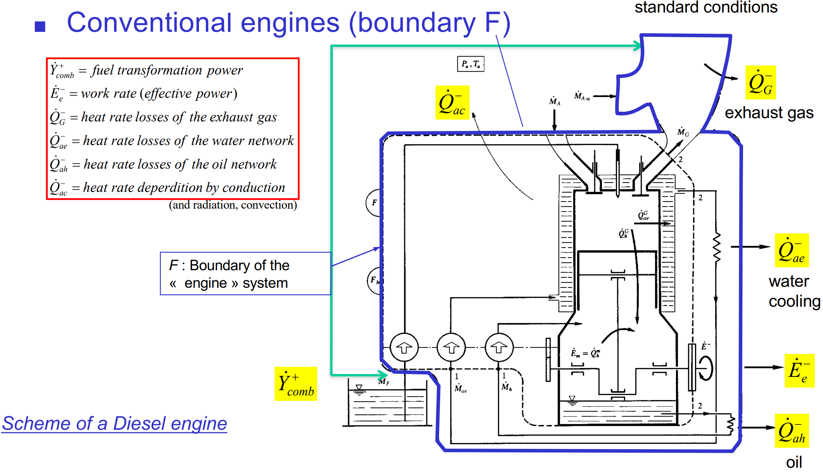
Exercise ENG3: Energy and exergy balance of a Diesel engine
Reference:
1. Formula Memento, Page 11
2. Lecture 4, page 31-36
M_{F} = 21.13 kg/h, M_{A}? R_{A/F}?

Slide 4

Exercise ENG3: Energy and exergy balance of a Diesel engine
Reference:
1. Formula Memento, Page 11
2. Lecture 4, page 31-36
M_{F} = 21.13 kg/h, M_{A}? R_{A/F}?
$$R_{A/F}=\frac{M_{A}}{M_{F}}=\frac{N_{A}}{M_{F}}⋅{\tilde{m}}_{A}$$

Slide 5
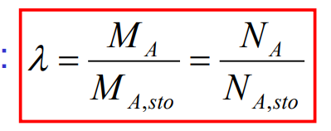

Exercise ENG3: Energy and exergy balance of a Diesel engine
Reference:
1. Formula Memento, Page 11
2. Lecture 4, page 31-36
M_{F} = 21.13 kg/h, M_{A}? R_{A/F}?
$$R_{A/F}=\frac{M_{A}}{M_{F}}=\frac{N_{A}}{M_{F}}⋅{\tilde{m}}_{A}$$
$R_{A/F}=\frac{λ⋅N_{A,stoi}}{M_{F}}⋅{\tilde{m}}_{A}=$ $\frac{λ⋅N_{O_{2},stoi}}{M_{F}⋅0.21}⋅{\tilde{m}}_{A}$

Slide 6

Exercise ENG3: Energy and exergy balance of a Diesel engine
Reference:
1. Formula Memento, Page 11
2. Lecture 4, page 31-36
M_{F} = 21.13 kg/h, M_{A}? R_{A/F}?
$$R_{A/F}=\frac{M_{A}}{M_{F}}=\frac{N_{A}}{M_{F}}⋅{\tilde{m}}_{A}$$
$R_{A/F}=\frac{λ⋅N_{A,stoi}}{M_{F}}⋅{\tilde{m}}_{A}=$ $\frac{λ⋅N_{O_{2},stoi}}{M_{F}⋅0.21}⋅{\tilde{m}}_{A}$
$$C+O_{2}=CO_{2} \\ H_{2}+\frac{1}{2}O_{2}=H_{2}O \\ S+O_{2}=SO_{2}$$
$R_{A/F}=\frac{λ}{M_{F}⋅0.21}⋅{\tilde{m}}_{A}$ $⋅\left(\frac{c_{C}^{F}}{{\tilde{m}}_{C}}+0.5⋅\frac{c_{H_{2}}^{F}}{{\tilde{m}}_{H_{2}}}+\frac{c_{S}^{F}}{{\tilde{m}}_{S}}−\frac{c_{O_{2}}^{F}}{{\tilde{m}}_{O_{2}}}\right)=17.24\frac{kgA}{kgF}$

Slide 7
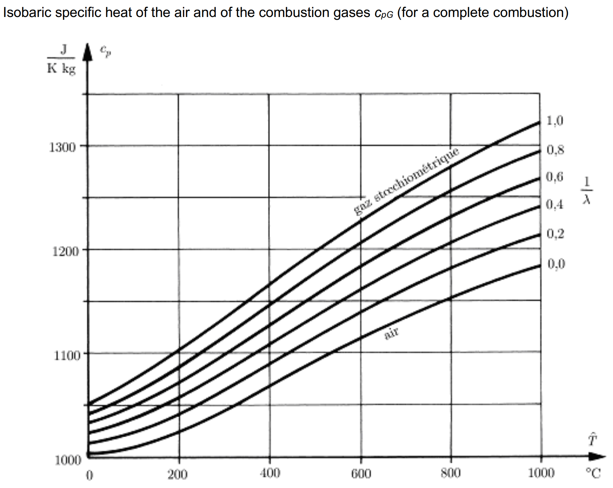
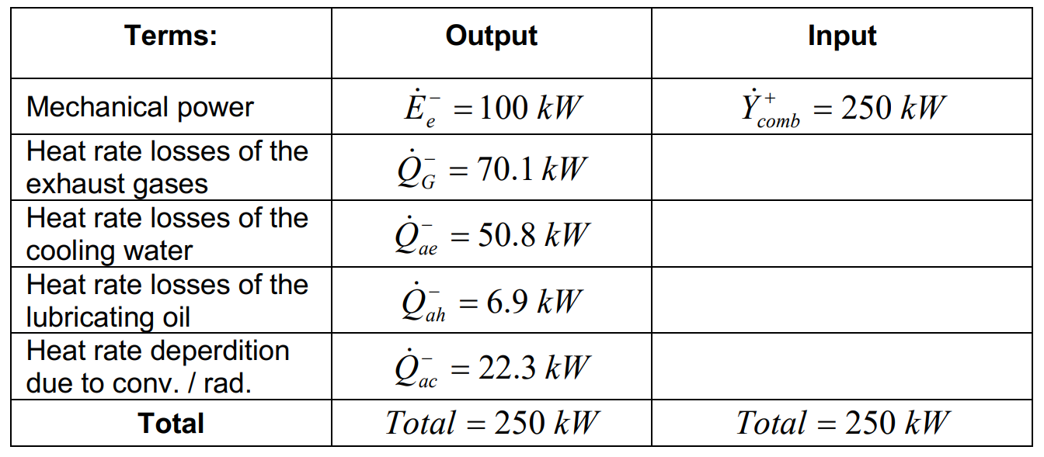
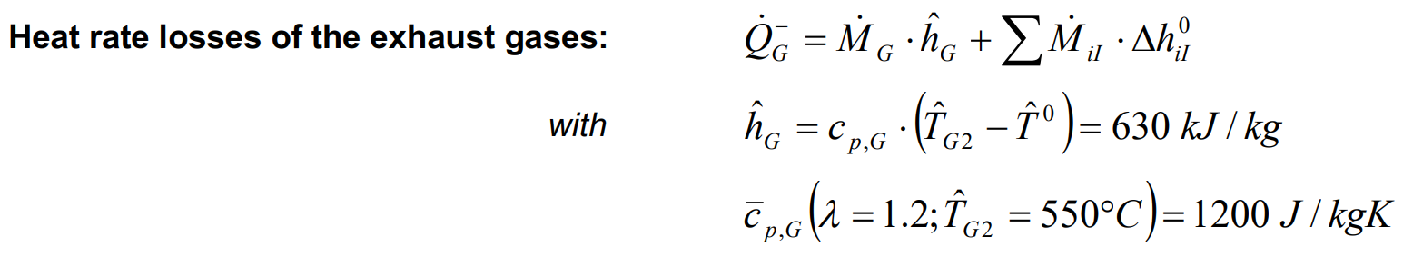

Exercise ENG3: Energy and exergy balance of a Diesel engine
Reference:
1. Formula Memento, Page 11
2. Lecture 4, page 31-36
$$R_{A/F}=17.24\frac{kgA}{kgF}$$

Slide 8
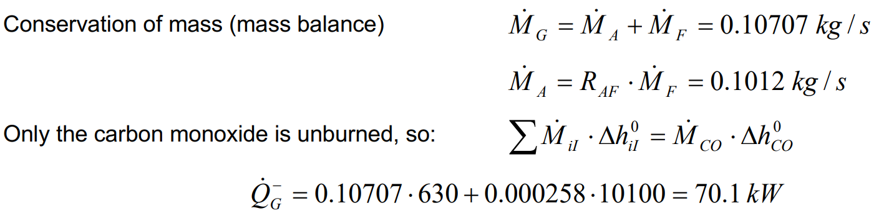
Exercise ENG3: Energy and exergy balance of a Diesel engine
Reference:
1. Formula Memento, Page 11
2. Lecture 4, page 31-36
$$R_{A/F}=17.24\frac{kgA}{kgF}$$

Slide 9
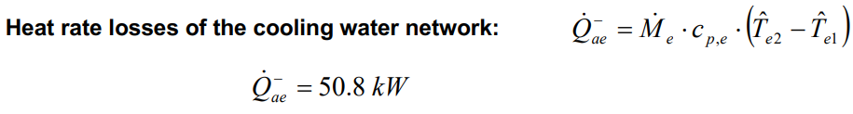
Exercise ENG3: Energy and exergy balance of a Diesel engine
Reference:
1. Formula Memento, Page 11
2. Lecture 4, page 31-36
$$R_{A/F}=17.24\frac{kgA}{kgF}$$

Slide 10
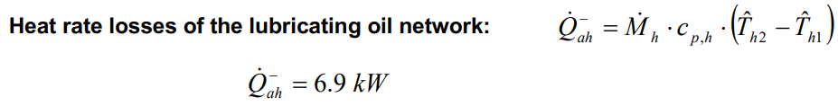
Exercise ENG3: Energy and exergy balance of a Diesel engine
Reference:
1. Formula Memento, Page 11
2. Lecture 4, page 31-36
$$R_{A/F}=17.24\frac{kgA}{kgF}$$

Slide 11
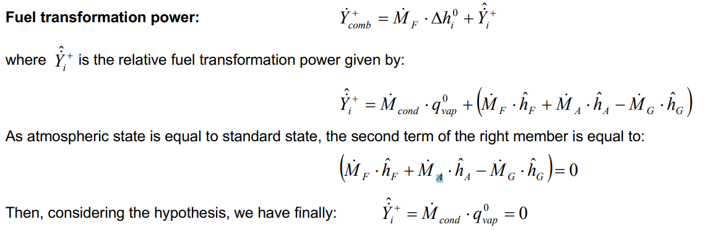
Exercise ENG3: Energy and exergy balance of a Diesel engine
Reference:
1. Formula Memento, Page 11
2. Lecture 4, page 31-36
$$R_{A/F}=17.24\frac{kgA}{kgF}$$

Slide 12
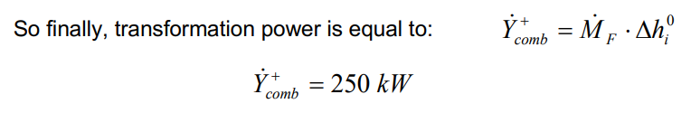
Exercise ENG3: Energy and exergy balance of a Diesel engine
Reference:
1. Formula Memento, Page 11
2. Lecture 4, page 31-36
$$R_{A/F}=17.24\frac{kgA}{kgF}$$

Slide 13
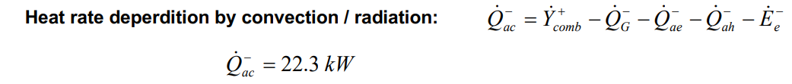
Exercise ENG3: Energy and exergy balance of a Diesel engine
Reference:
1. Formula Memento, Page 11
2. Lecture 4, page 31-36
$$R_{A/F}=17.24\frac{kgA}{kgF}$$

Slide 14
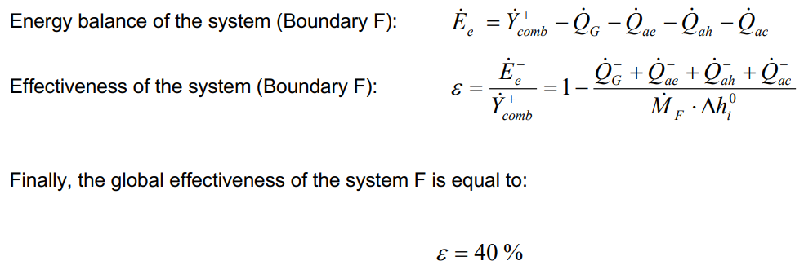
Exercise ENG3: Energy and exergy balance of a Diesel engine
Reference:
1. Formula Memento, Page 11
2. Lecture 4, page 31-36
$$R_{A/F}=17.24\frac{kgA}{kgF}$$

Slide 15
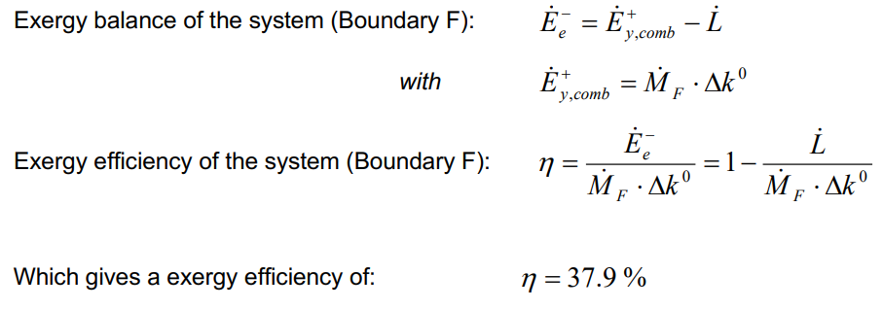
Exercise ENG3: Energy and exergy balance of a Diesel engine
Reference:
1. Formula Memento, Page 11
2. Lecture 4, page 31-36
$$R_{A/F}=17.24\frac{kgA}{kgF}$$
Notes:
燃料的火用值（exergy value）通常比地位热值（lower heating value, LHV）要高，原因在于火用值不仅考虑了燃料中能量的总量，还考虑了该能量的可用性和有序性，而地位热值只是燃料燃烧时释放的热量总和。
以下是一些关键的原因和解释：
1. 火用值考虑能量的有序性
火用值反映了燃料中能够转化为有用功的那一部分能量，既包括热量，也包括有序能量（如机械能、电能等）。热量是较低质量的能量形式，而火用值能够量化能量的“质量”或有用程度。例如，在燃烧过程中，一部分能量由于熵的增加无法用于做功，火用值将排除这部分不可用的能量。
2. 地位热值只计算热能释放
地位热值仅仅是燃料完全燃烧时释放的热能量，它不考虑能量转化过程中的有序性和可用性。它是热化学计算中用于评估燃料燃烧时所产生的热量（通常是以水蒸气状态的水释放热量为标准），因此它并未考虑到能量的可用性。
3. 火用值计算考虑环境因素
火用值不仅考虑了燃料本身的内在能量，还将环境的温度和压力因素纳入考虑。它计算的是燃料在给定的环境条件下，最大可能转化为有用功的那部分能量。即便燃料燃烧放出了大量热量，如果这些热量在与环境温差不大的情况下释放，则它们能够用于做功的潜力较小。
4. 不可逆过程的能量损失
在实际过程中，能量转换往往伴随着不可逆的过程（如摩擦、热传导等），导致一部分能量不可用。火用值衡量了可用能量，而地位热值未能反映这些损失。尽管燃料燃烧释放了大量能量，但其中有相当一部分因不可逆过程而损失，不再能够用于实际做功，而这部分能量的损失在火用值中得到了体现。
结论：
火用值比地位热值高的根本原因在于，火用值是衡量燃料中能量的可用性，即能够有效转化为有用功的那部分能量。而地位热值只是燃料燃烧释放的总热量，未考虑能量的有序性和实际利用效率。因此，火用值提供了更准确的能量利用潜力的衡量标准。

Slide 16
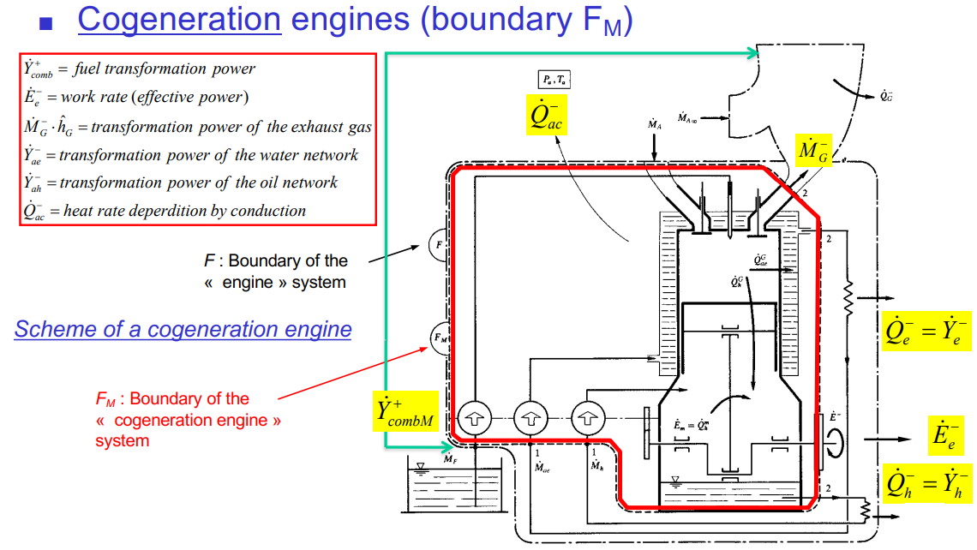
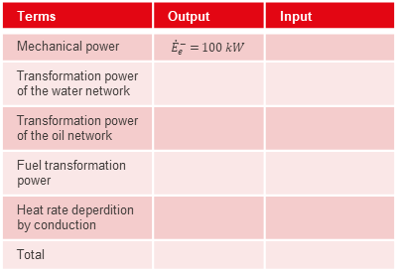
Exercise ENG3: Energy and exergy balance of a Diesel engine
Reference:
1. Formula Memento, Page 11
2. Lecture 4, page 31-36
$${\dot{Q}}_{ae}^{−}={\dot{Y}}_{ae}^{−}$$
$${\dot{Q}}_{ah}^{−}={\dot{Y}}_{ah}^{−}$$
Terms | Output | Input
Mechanical power | $${\dot{E}}_{e}^{−}=100 kW$$
Transformation power of the water network
Transformation power of the oil network
Fuel transformation power
Heat rate deperdition by conduction
Total
$$R_{A/F}=17.24\frac{kgA}{kgF}$$

Slide 17
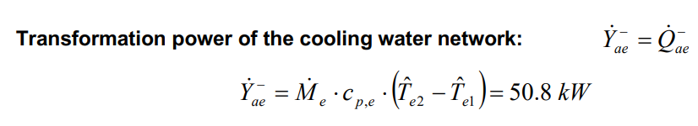
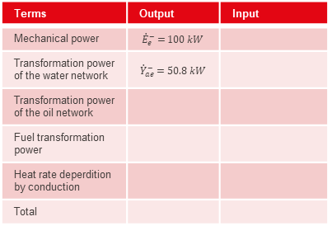
Exercise ENG3: Energy and exergy balance of a Diesel engine
Reference:
1. Formula Memento, Page 11
2. Lecture 4, page 31-36
$${\dot{Q}}_{ae}^{−}={\dot{Y}}_{ae}^{−}$$
$${\dot{Q}}_{ah}^{−}={\dot{Y}}_{ah}^{−}$$
Terms | Output | Input
Mechanical power | $${\dot{E}}_{e}^{−}=100 kW$$
Transformation power of the water network | $${\dot{Y}}_{ae}^{−}=50.8 kW$$
Transformation power of the oil network
Fuel transformation power
Heat rate deperdition by conduction
Total
$$R_{A/F}=17.24\frac{kgA}{kgF}$$

Slide 18
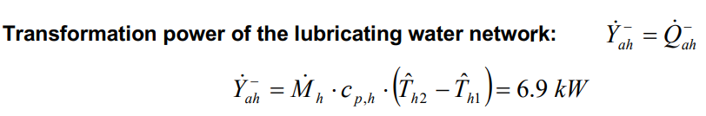
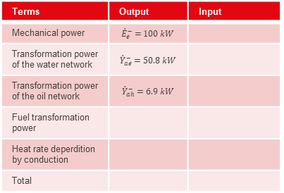
Exercise ENG3: Energy and exergy balance of a Diesel engine
Reference:
1. Formula Memento, Page 11
2. Lecture 4, page 31-36
$${\dot{Q}}_{ae}^{−}={\dot{Y}}_{ae}^{−}$$
$${\dot{Q}}_{ah}^{−}={\dot{Y}}_{ah}^{−}$$
Terms | Output | Input
Mechanical power | $${\dot{E}}_{e}^{−}=100 kW$$
Transformation power of the water network | $${\dot{Y}}_{ae}^{−}=50.8 kW$$
Transformation power of the oil network | $${\dot{Y}}_{ah}^{−}=6.9 kW$$
Fuel transformation power
Heat rate deperdition by conduction
Total
$$R_{A/F}=17.24\frac{kgA}{kgF}$$

Slide 19
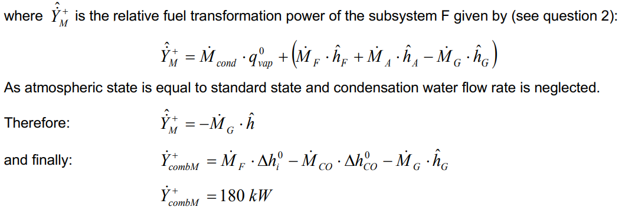
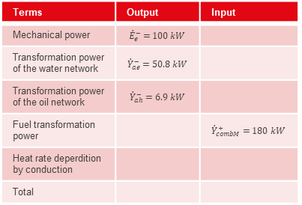
Exercise ENG3: Energy and exergy balance of a Diesel engine
Reference:
1. Formula Memento, Page 11
2. Lecture 4, page 31-36
$${\dot{Q}}_{ae}^{−}={\dot{Y}}_{ae}^{−}$$
$${\dot{Q}}_{ah}^{−}={\dot{Y}}_{ah}^{−}$$
Terms | Output | Input
Mechanical power | $${\dot{E}}_{e}^{−}=100 kW$$
Transformation power of the water network | $${\dot{Y}}_{ae}^{−}=50.8 kW$$
Transformation power of the oil network | $${\dot{Y}}_{ah}^{−}=6.9 kW$$
Fuel transformation power |  | $${\dot{Y}}_{combM}^{+}=180 kW$$
Heat rate deperdition by conduction
Total
With boundary F_{M}, the outlet temperature is 550 ºC rather than 25 ºC
$$R_{A/F}=17.24\frac{kgA}{kgF}$$

Slide 20
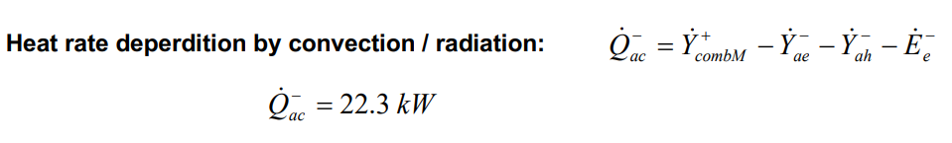
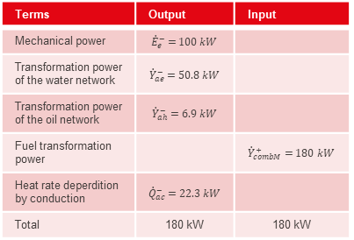
Exercise ENG3: Energy and exergy balance of a Diesel engine
Reference:
1. Formula Memento, Page 11
2. Lecture 4, page 31-36
$${\dot{Q}}_{ae}^{−}={\dot{Y}}_{ae}^{−}$$
$${\dot{Q}}_{ah}^{−}={\dot{Y}}_{ah}^{−}$$
Terms | Output | Input
Mechanical power | $${\dot{E}}_{e}^{−}=100 kW$$
Transformation power of the water network | $${\dot{Y}}_{ae}^{−}=50.8 kW$$
Transformation power of the oil network | $${\dot{Y}}_{ah}^{−}=6.9 kW$$
Fuel transformation power |  | $${\dot{Y}}_{combM}^{+}=180 kW$$
Heat rate deperdition by conduction | $${\dot{Q}}_{ac}^{−}=22.3 kW$$
Total | 180 kW | 180 kW
$$R_{A/F}=17.24\frac{kgA}{kgF}$$

Slide 21
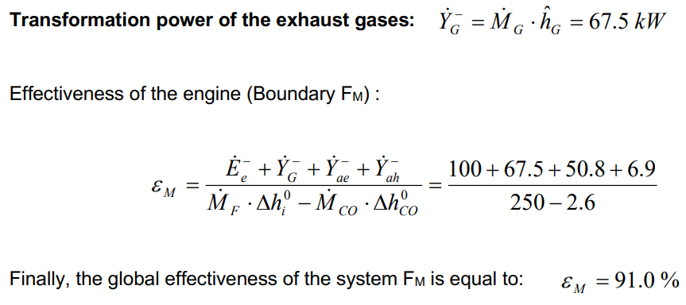
Exercise ENG3: Energy and exergy balance of a Diesel engine
Reference:
1. Formula Memento, Page 11
2. Lecture 4, page 31-36
$${\dot{Q}}_{ae}^{−}={\dot{Y}}_{ae}^{−}$$
$${\dot{Q}}_{ah}^{−}={\dot{Y}}_{ah}^{−}$$
Terms | Output | Input
Mechanical power | $${\dot{E}}_{e}^{−}=100 kW$$
Transformation power of the water network | $${\dot{Y}}_{ae}^{−}=50.8 kW$$
Transformation power of the oil network | $${\dot{Y}}_{ah}^{−}=6.9 kW$$
Fuel transformation power |  | $${\dot{Y}}_{combM}^{+}=180 kW$$
Heat rate deperdition by conduction | $${\dot{Q}}_{ac}^{−}=22.3 kW$$
Total | 180 kW | 180 kW
Exhaust gas transformation power should be included as it’s a potential of energy service provided by the system
$$R_{A/F}=17.24\frac{kgA}{kgF}$$

Slide 22
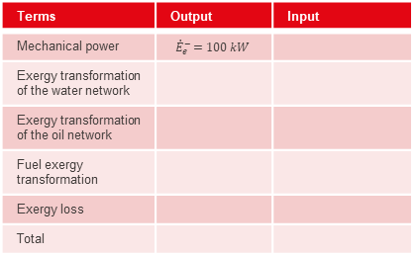
Exercise ENG3: Energy and exergy balance of a Diesel engine
Reference:
1. Formula Memento, Page 11
2. Lecture 4, page 31-36
$${\dot{Q}}_{ae}^{−}={\dot{Y}}_{ae}^{−}$$
$${\dot{Q}}_{ah}^{−}={\dot{Y}}_{ah}^{−}$$
Terms | Output | Input
Mechanical power | $${\dot{E}}_{e}^{−}=100 kW$$
Exergy transformation of the water network
Exergy transformation of the oil network
Fuel exergy transformation
Exergy loss
Total
$$R_{A/F}=17.24\frac{kgA}{kgF}$$

Slide 23
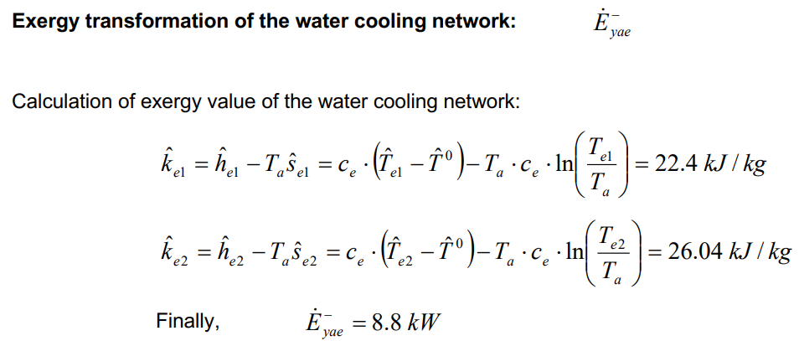
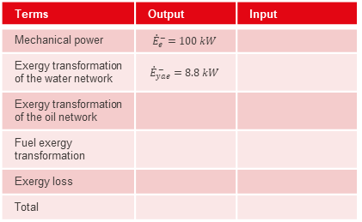
Exercise ENG3: Energy and exergy balance of a Diesel engine
Reference:
1. Formula Memento, Page 11
2. Lecture 4, page 31-36
$${\dot{Q}}_{ae}^{−}={\dot{Y}}_{ae}^{−}$$
$${\dot{Q}}_{ah}^{−}={\dot{Y}}_{ah}^{−}$$
Terms | Output | Input
Mechanical power | $${\dot{E}}_{e}^{−}=100 kW$$
Exergy transformation of the water network | $${\dot{E}}_{yae}^{−}=8.8 kW$$
Exergy transformation of the oil network
Fuel exergy transformation
Exergy loss
Total
$$R_{A/F}=17.24\frac{kgA}{kgF}$$

Slide 24
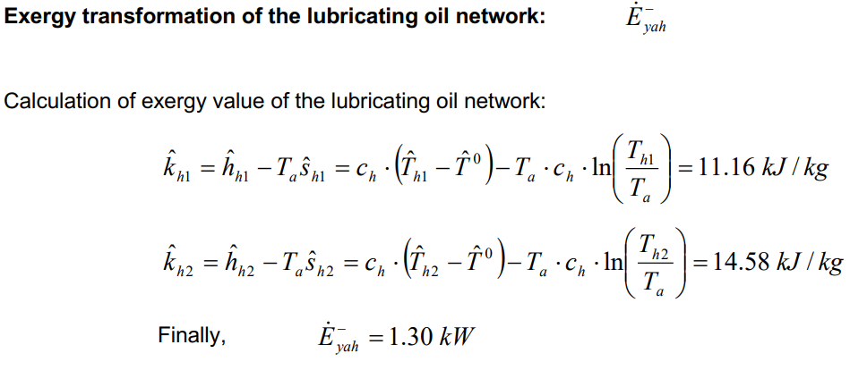
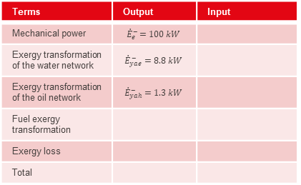
Exercise ENG3: Energy and exergy balance of a Diesel engine
Reference:
1. Formula Memento, Page 11
2. Lecture 4, page 31-36
$${\dot{Q}}_{ae}^{−}={\dot{Y}}_{ae}^{−}$$
$${\dot{Q}}_{ah}^{−}={\dot{Y}}_{ah}^{−}$$
Terms | Output | Input
Mechanical power | $${\dot{E}}_{e}^{−}=100 kW$$
Exergy transformation of the water network | $${\dot{E}}_{yae}^{−}=8.8 kW$$
Exergy transformation of the oil network | $${\dot{E}}_{yah}^{−}=1.3 kW$$
Fuel exergy transformation
Exergy loss
Total
$$R_{A/F}=17.24\frac{kgA}{kgF}$$

Slide 25
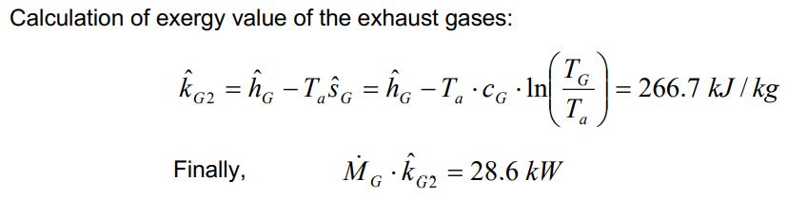
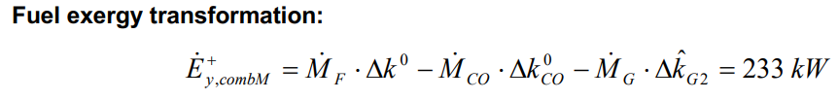
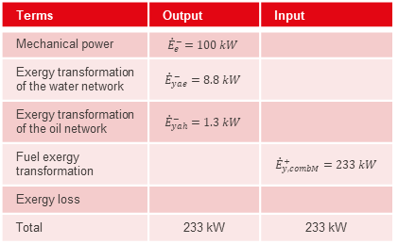
Exercise ENG3: Energy and exergy balance of a Diesel engine
Reference:
1. Formula Memento, Page 11
2. Lecture 4, page 31-36
$${\dot{Q}}_{ae}^{−}={\dot{Y}}_{ae}^{−}$$
$${\dot{Q}}_{ah}^{−}={\dot{Y}}_{ah}^{−}$$
Terms | Output | Input
Mechanical power | $${\dot{E}}_{e}^{−}=100 kW$$
Exergy transformation of the water network | $${\dot{E}}_{yae}^{−}=8.8 kW$$
Exergy transformation of the oil network | $${\dot{E}}_{yah}^{−}=1.3 kW$$
Fuel exergy transformation |  | $${\dot{E}}_{y, combM}^{+}=233 kW$$
Exergy loss
Total | 233 kW | 233 kW
$$R_{A/F}=17.24\frac{kgA}{kgF}$$

Slide 26
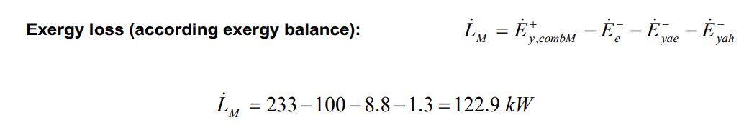
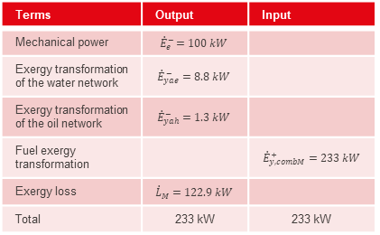
Exercise ENG3: Energy and exergy balance of a Diesel engine
Reference:
1. Formula Memento, Page 11
2. Lecture 4, page 31-36
$${\dot{Q}}_{ae}^{−}={\dot{Y}}_{ae}^{−}$$
$${\dot{Q}}_{ah}^{−}={\dot{Y}}_{ah}^{−}$$
Terms | Output | Input
Mechanical power | $${\dot{E}}_{e}^{−}=100 kW$$
Exergy transformation of the water network | $${\dot{E}}_{yae}^{−}=8.8 kW$$
Exergy transformation of the oil network | $${\dot{E}}_{yah}^{−}=1.3 kW$$
Fuel exergy transformation |  | $${\dot{E}}_{y, combM}^{+}=233 kW$$
Exergy loss | $${\dot{L}}_{M}=122.9 kW$$
Total | 233 kW | 233 kW
$$R_{A/F}=17.24\frac{kgA}{kgF}$$

Slide 27
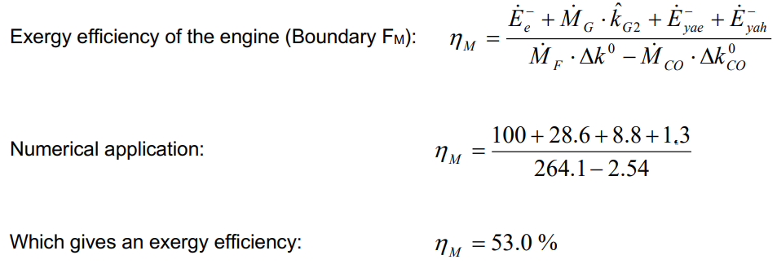
Exercise ENG3: Energy and exergy balance of a Diesel engine
Reference:
1. Formula Memento, Page 11
2. Lecture 4, page 31-36
$${\dot{Q}}_{ae}^{−}={\dot{Y}}_{ae}^{−}$$
$${\dot{Q}}_{ah}^{−}={\dot{Y}}_{ah}^{−}$$
Terms | Output | Input
Mechanical power | $${\dot{E}}_{e}^{−}=100 kW$$
Exergy transformation of the water network | $${\dot{E}}_{yae}^{−}=8.8 kW$$
Exergy transformation of the oil network | $${\dot{E}}_{yah}^{−}=1.3 kW$$
Fuel exergy transformation |  | $${\dot{E}}_{y, combM}^{+}=233 kW$$
Exergy loss | $${\dot{L}}_{M}=122.9 kW$$
Total | 233 kW | 233 kW
$$R_{A/F}=17.24\frac{kgA}{kgF}$$

Slide 28
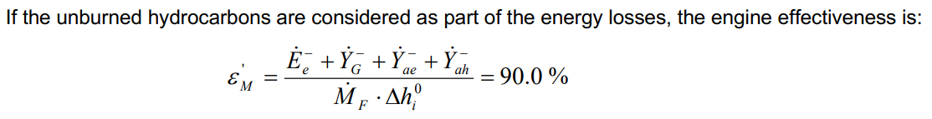
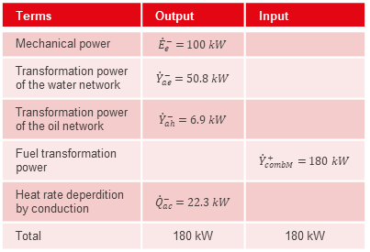
Exercise ENG3: Energy and exergy balance of a Diesel engine
Reference:
1. Formula Memento, Page 11
2. Lecture 4, page 31-36
Terms | Output | Input
Mechanical power | $${\dot{E}}_{e}^{−}=100 kW$$
Transformation power of the water network | $${\dot{Y}}_{ae}^{−}=50.8 kW$$
Transformation power of the oil network | $${\dot{Y}}_{ah}^{−}=6.9 kW$$
Fuel transformation power |  | $${\dot{Y}}_{combM}^{+}=180 kW$$
Heat rate deperdition by conduction | $${\dot{Q}}_{ac}^{−}=22.3 kW$$
Total | 180 kW | 180 kW
$$R_{A/F}=17.24\frac{kgA}{kgF}$$

Slide 29
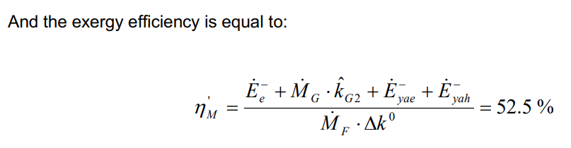
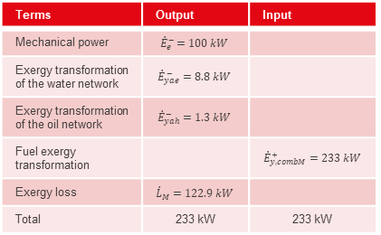
Exercise ENG3: Energy and exergy balance of a Diesel engine
Reference:
1. Formula Memento, Page 11
2. Lecture 4, page 31-36
Terms | Output | Input
Mechanical power | $${\dot{E}}_{e}^{−}=100 kW$$
Exergy transformation of the water network | $${\dot{E}}_{yae}^{−}=8.8 kW$$
Exergy transformation of the oil network | $${\dot{E}}_{yah}^{−}=1.3 kW$$
Fuel exergy transformation |  | $${\dot{E}}_{y, combM}^{+}=233 kW$$
Exergy loss | $${\dot{L}}_{M}=122.9 kW$$
Total | 233 kW | 233 kW
$$R_{A/F}=17.24\frac{kgA}{kgF}$$

Slide 30
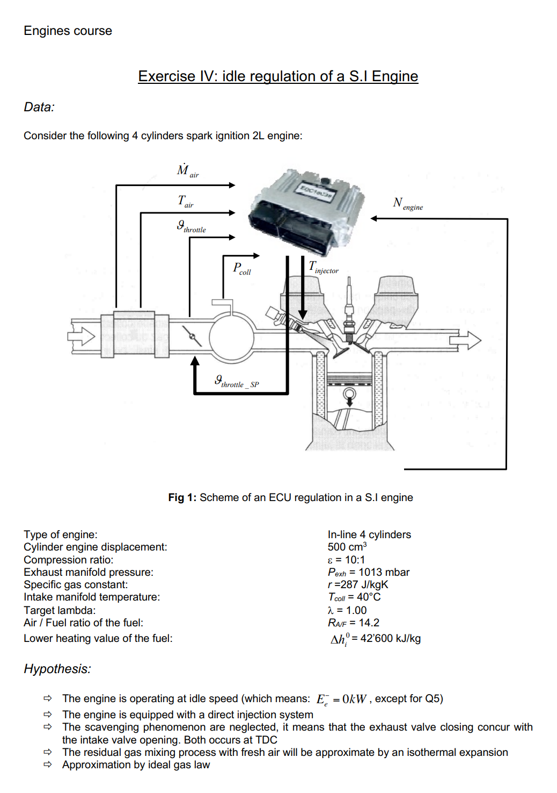
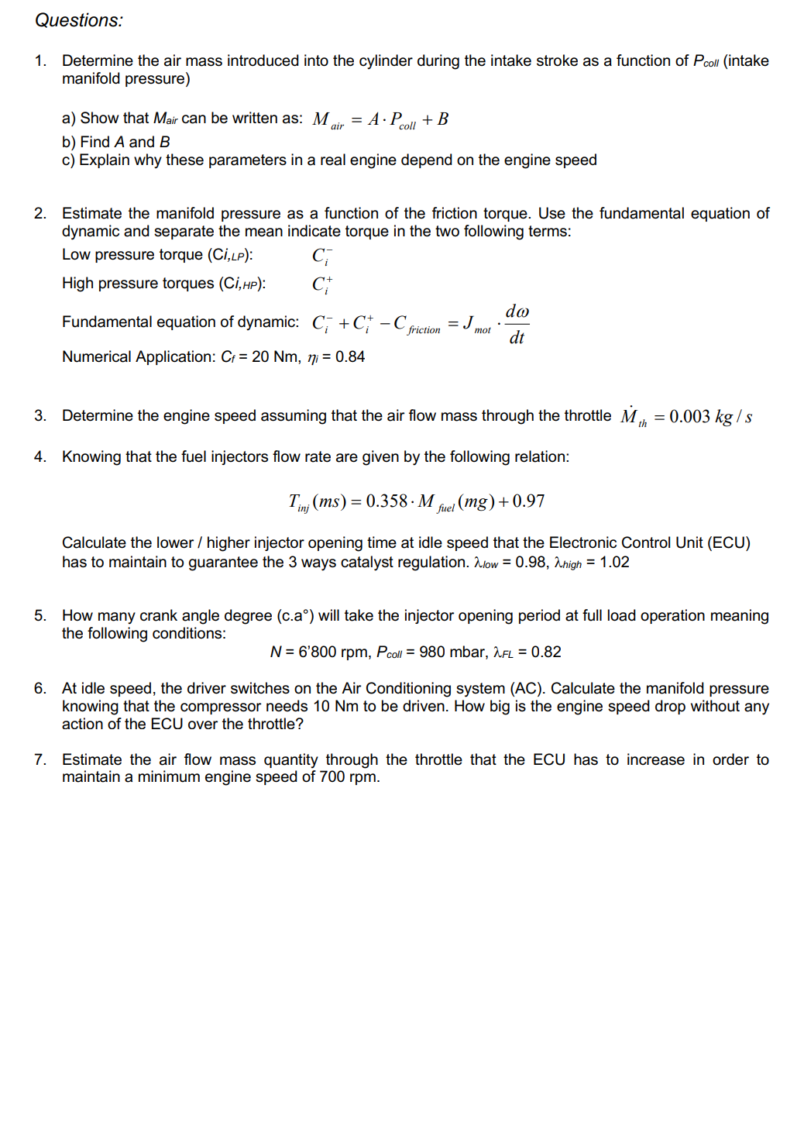
Exercise ENG4: idle regulation of a S.I. Engine
Notes:
1. 背景与核心问题
这道习题围绕火花点火式（SI）发动机的怠速控制展开。怠速是指发动机在不加载的情况下以低速运转时的状态。通过控制进气、燃油喷射和排气，发动机能够在怠速时稳定运行，而电子控制单元（ECU）在其中扮演了重要角色。
对于你们之前学习的柴油发动机，着重于压燃（即燃料自燃），而在火花点火发动机中，燃料与空气混合后通过火花塞点燃。尽管点火方式不同，热力学过程在两种发动机中仍是相通的，涉及进气、压缩、燃烧和排气这几个基本循环。
2. 习题结构概述
这个习题主要由几个部分组成，每部分都涉及怠速控制中不同的关键因素：
• 空气质量流量：我们需要确定在进气歧管的压力下，每个进气冲程进入气缸的空气质量。通过这一部分，可以理解发动机如何根据不同的进气条件调整进气量以维持稳定运行。
• 进气歧管压力：进气歧管压力是怠速控制的核心，它与发动机的摩擦扭矩密切相关。通过分解为高压和低压部分，你们可以应用热力学和流体力学知识来分析发动机内部的复杂动态过程。
• 燃油喷射器的控制：燃油喷射系统在发动机工作中至关重要。此题通过喷油器的时间与喷射质量的关系，探讨了在怠速时 ECU 如何通过调整喷油时间来维持三元催化器的有效运作。
3. 关键参数与方程式
• 在柴油机中，扭矩和进气量的控制主要通过节气门和进气歧管压力来实现。而在这里，你们需要应用类似的知识来理解怠速时的进气质量流量公式：
\dot{M}{\text{air}} = A \cdot P{\text{out}} + B
这个线性模型说明了进气质量流量与歧管压力的关系，并且你们会深入探讨系数 A 和 B 的物理意义。
• 摩擦扭矩是另一个需要特别关注的因素，它直接影响发动机的效率和怠速稳定性。在此题中，它被拆分为低压和高压部分，帮助你们理解不同负荷条件下的发动机运行状态。
4. 实际应用与仿真分析
• 在后面的部分，题目会引导你们估算发动机的转速，并利用喷油器时间与燃油质量的关系，来探索 ECU 如何调整发动机的运行状态。你们可以结合之前学习的柴油引擎喷油系统，比较两者在不同工作条件下的差异。
• 第五题讨论了曲轴角度和转速的关系，这部分与柴油引擎的工作方式类似，因为它也要求计算发动机在给定负荷下的角度变化，这对发动机性能优化十分重要。
• 最后，题目让你们分析空调系统对怠速的影响。在实际应用中，发动机往往要应对各种外部负载，例如空调系统的开启会增加扭矩需求，进而影响发动机的转速和稳定性。你们可以将此与之前学习的热力学循环相结合，理解发动机如何适应这种额外的能量需求。
5. 与柴油机的比较和总结
在讨论火花点火发动机与柴油发动机的异同时，强调二者虽然点火方式不同，但在调节进气、燃油喷射和扭矩管理等方面有相似之处。这个习题提供了一个很好的机会，让你们通过分析具体问题，理解怠速控制中的空气动力学、热力学和系统动力学等复杂交互作用。
研究怠速控制不仅有助于你们理解发动机在低负荷下的性能优化，也为未来深入探讨燃油经济性、排放控制和现代电子控制系统提供了基础。
通过这种方式，你们将能够更好地掌握火花点火发动机怠速控制的核心概念，并将所学的热力学、流体力学和柴油机知识应用到具体的工程问题中。

